Slide 1


Atliq Technology Profit and loss optimisation
Author – Mithun Nagesh Shet

Slide 2
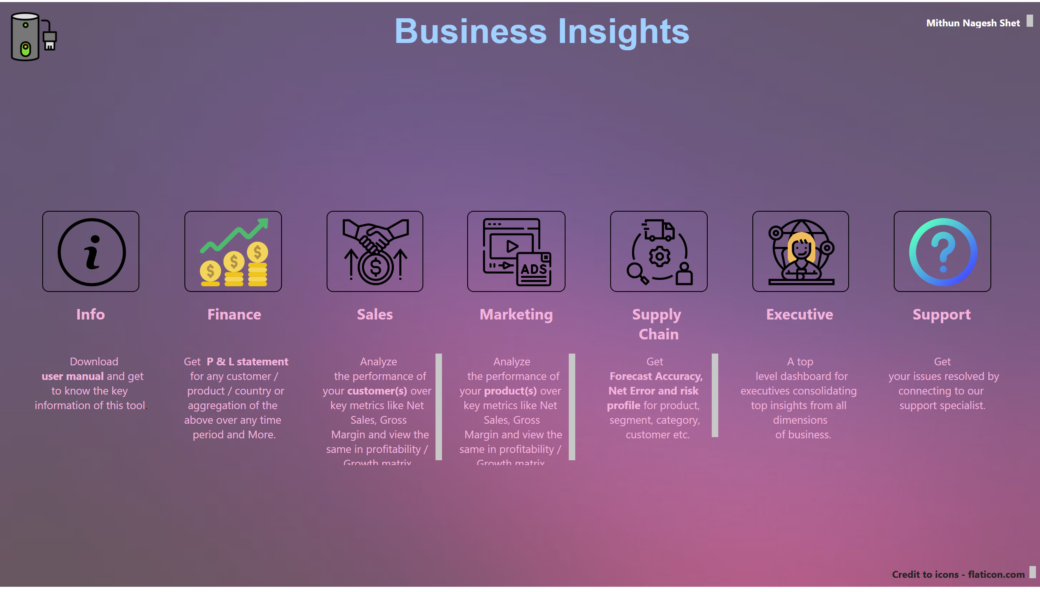
Home
Notes:
image
No alt text provided
image
No alt text provided
image
No alt text provided
image
No alt text provided
image
No alt text provided
image
No alt text provided
image
No alt text provided
textbox
No alt text provided
textbox
No alt text provided
textbox
No alt text provided
textbox
No alt text provided
textbox
No alt text provided
textbox
No alt text provided
textbox
No alt text provided
textbox
No alt text provided
textbox
No alt text provided
textbox
No alt text provided
textbox
No alt text provided
textbox
No alt text provided
textbox
No alt text provided
textbox
No alt text provided
textbox
No alt text provided
textbox
No alt text provided
textbox
No alt text provided
textbox
No alt text provided
image
No alt text provided

Slide 3
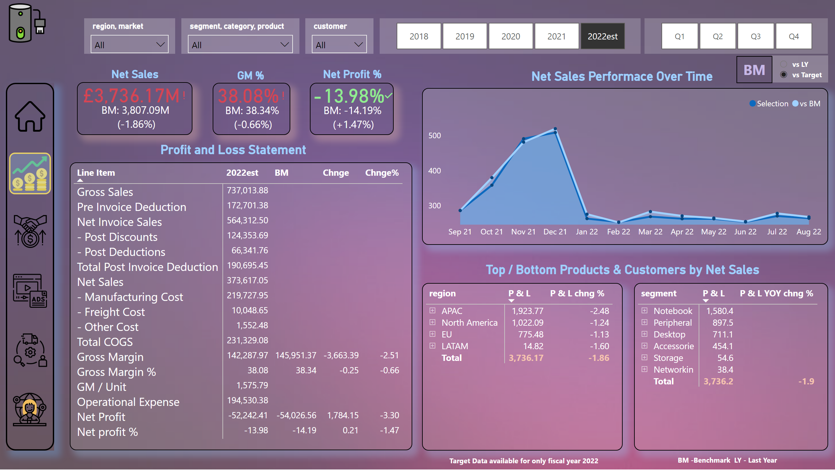
Finance View_main
Notes:
pivotTable
No alt text provided
slicer
No alt text provided
slicer
No alt text provided
Net Sales Performace Over Time
No alt text provided
pivotTable
No alt text provided
pivotTable
No alt text provided
card
No alt text provided
card
No alt text provided
textbox
No alt text provided
slicer
No alt text provided
slicer
No alt text provided
slicer
No alt text provided
kpi
No alt text provided
textbox
No alt text provided
kpi
No alt text provided
textbox
No alt text provided
kpi
No alt text provided
textbox
No alt text provided
shape
No alt text provided
image
No alt text provided
image
No alt text provided
image
No alt text provided
image
No alt text provided
image
No alt text provided
image
No alt text provided
shape
No alt text provided
slicer
No alt text provided
textbox
No alt text provided
card
No alt text provided
textbox
No alt text provided
textbox
No alt text provided
image
No alt text provided

Slide 4
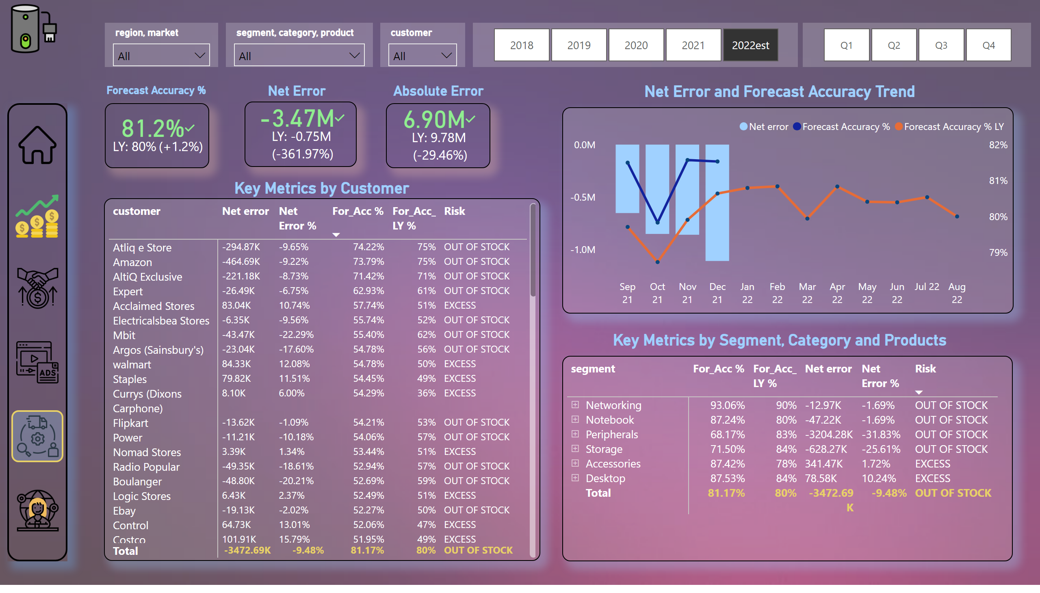
Supply Chain view_main
Notes:
slicer
No alt text provided
slicer
No alt text provided
textbox
No alt text provided
slicer
No alt text provided
slicer
No alt text provided
slicer
No alt text provided
kpi
No alt text provided
textbox
No alt text provided
kpi
No alt text provided
textbox
No alt text provided
kpi
No alt text provided
textbox
No alt text provided
shape
No alt text provided
image
No alt text provided
image
No alt text provided
image
No alt text provided
image
No alt text provided
image
No alt text provided
image
No alt text provided
shape
No alt text provided
pivotTable
No alt text provided
lineClusteredColumnComboChart
No alt text provided
pivotTable
No alt text provided
textbox
No alt text provided
textbox
No alt text provided
image
No alt text provided

Slide 5
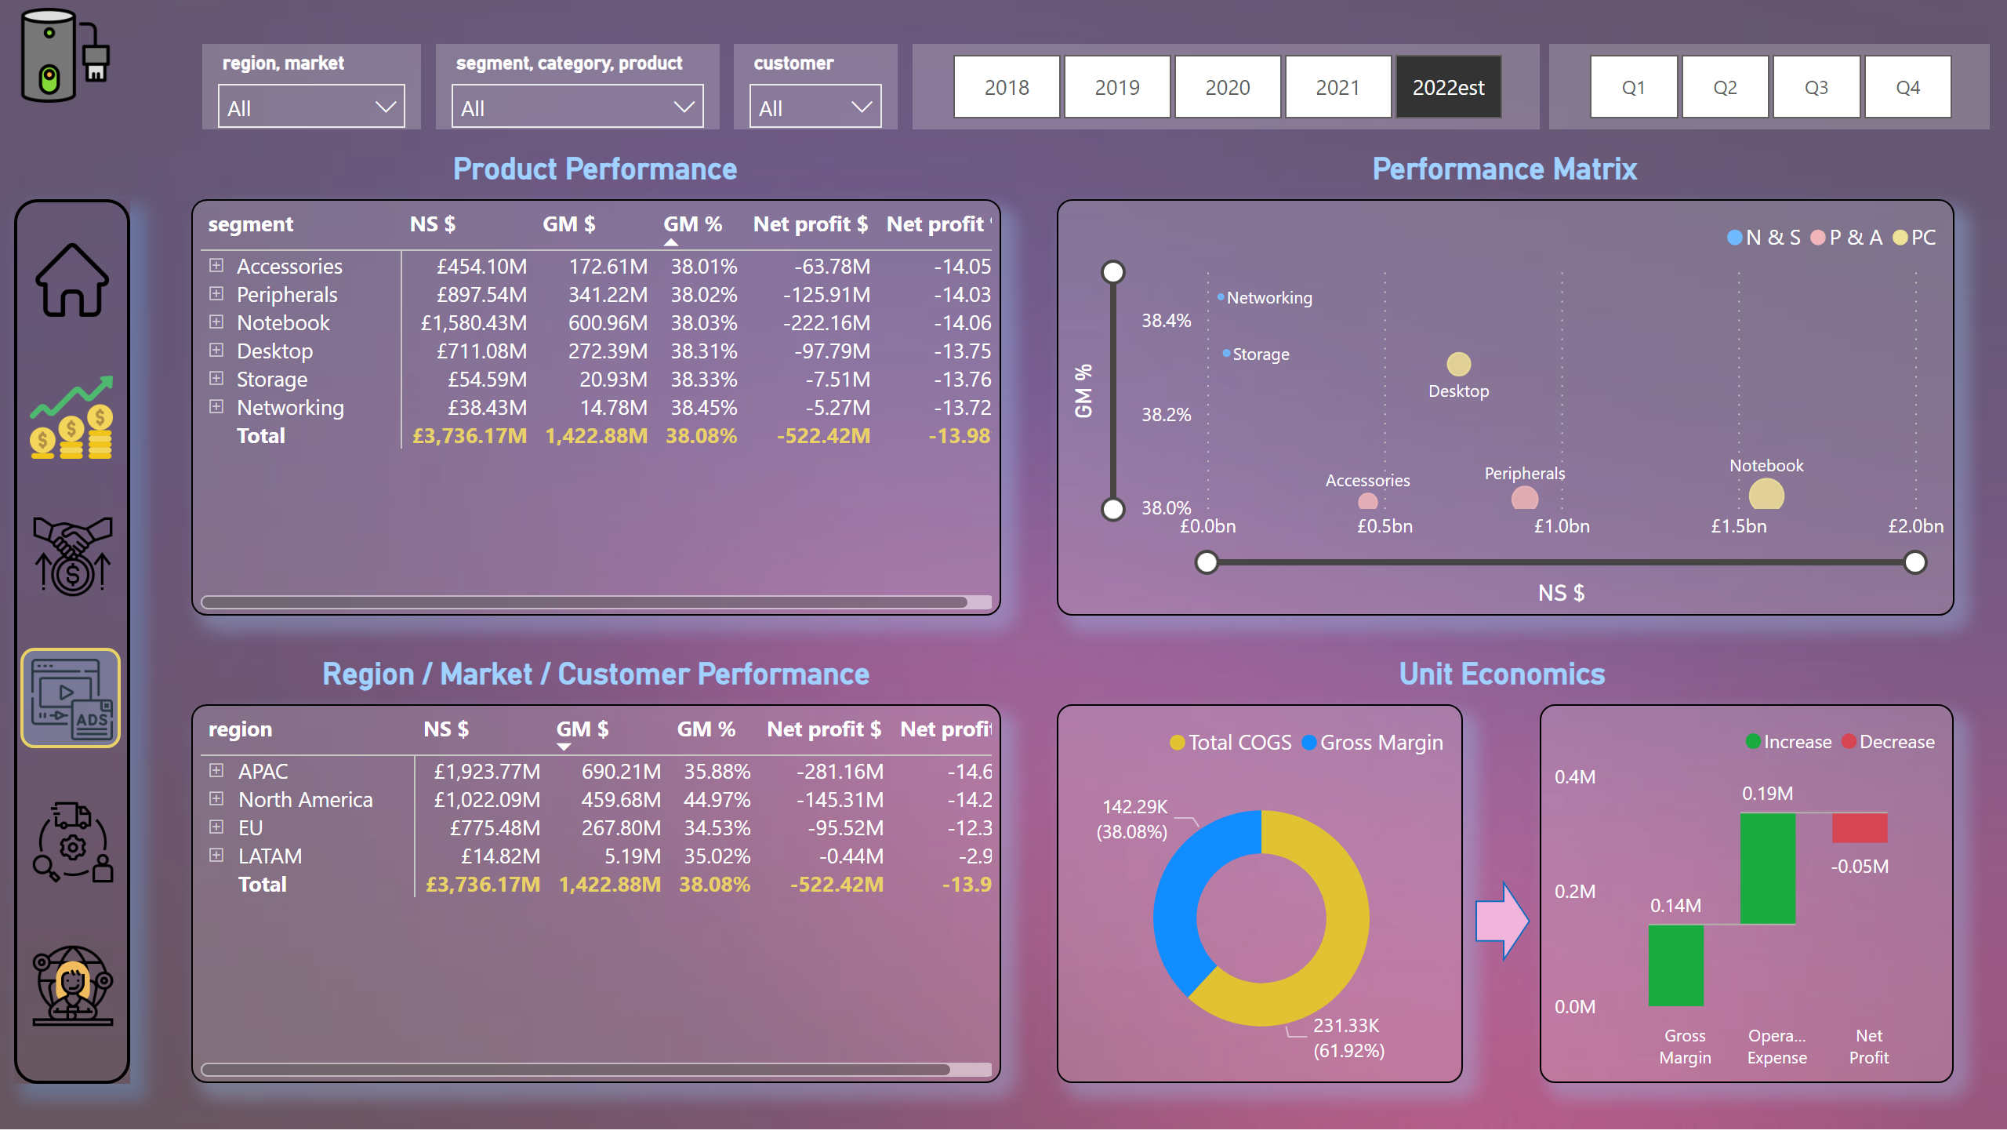
marketing view_main
Notes:
slicer
No alt text provided
slicer
No alt text provided
slicer
No alt text provided
slicer
No alt text provided
slicer
No alt text provided
shape
No alt text provided
image
No alt text provided
image
No alt text provided
image
No alt text provided
image
No alt text provided
image
No alt text provided
image
No alt text provided
shape
No alt text provided
textbox
No alt text provided
pivotTable
No alt text provided
textbox
No alt text provided
scatterChart
No alt text provided
pivotTable
No alt text provided
textbox
No alt text provided
donutChart
No alt text provided
shape
No alt text provided
waterfallChart
No alt text provided
textbox
No alt text provided
image
No alt text provided

Slide 6
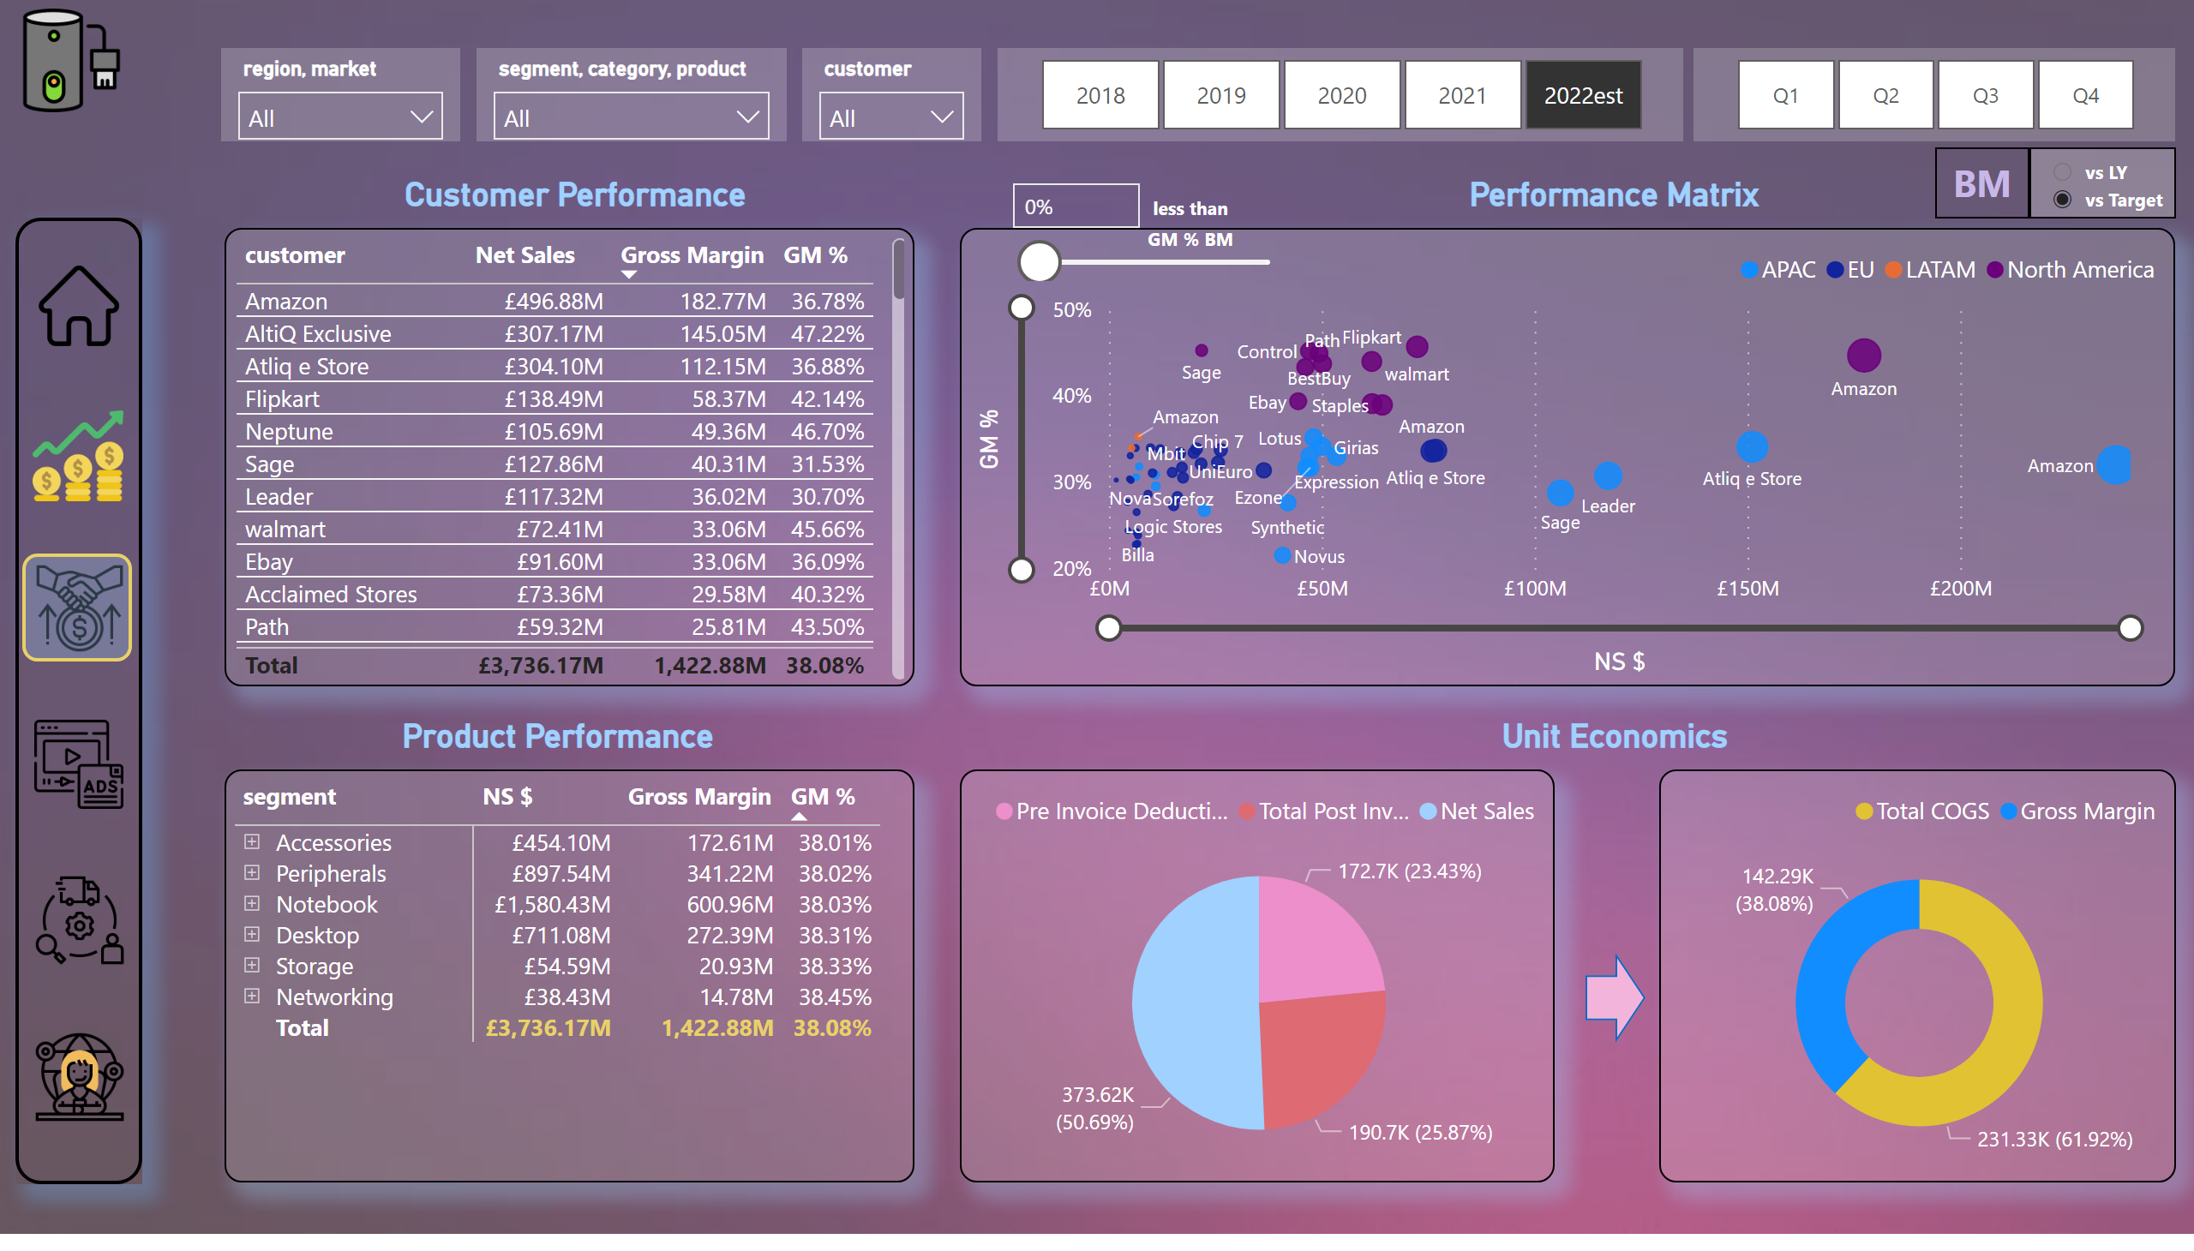
Sales View_main
Notes:
slicer
No alt text provided
slicer
No alt text provided
slicer
No alt text provided
slicer
No alt text provided
slicer
No alt text provided
shape
No alt text provided
image
No alt text provided
image
No alt text provided
image
No alt text provided
image
No alt text provided
image
No alt text provided
image
No alt text provided
shape
No alt text provided
textbox
No alt text provided
textbox
No alt text provided
textbox
No alt text provided
shape
No alt text provided
textbox
No alt text provided
tableEx
No alt text provided
scatterChart
No alt text provided
pivotTable
No alt text provided
pieChart
No alt text provided
donutChart
No alt text provided
slicer
No alt text provided
textbox
No alt text provided
slicer
No alt text provided
card
No alt text provided
textbox
No alt text provided
image
No alt text provided

